Slide 1
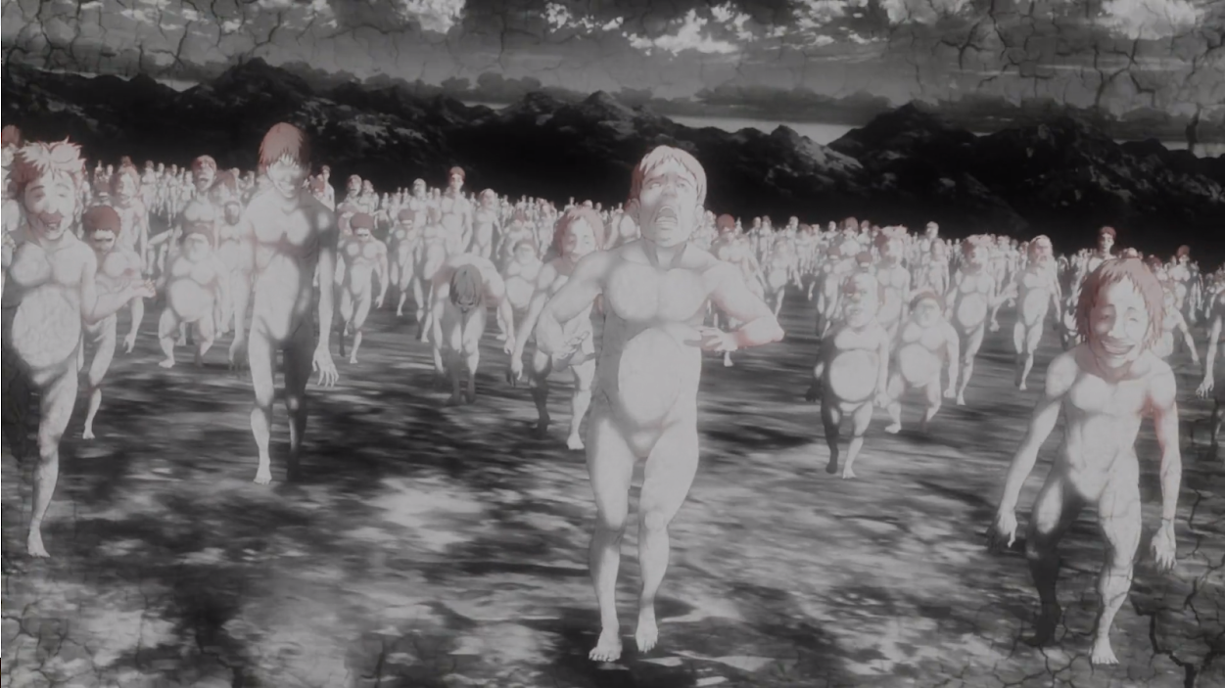
アニメ
Anime Zombies
Kevin Kooh and Andrew Chafos
Notes:
15

Slide 2
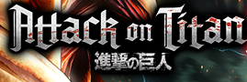

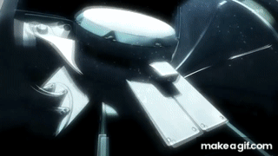
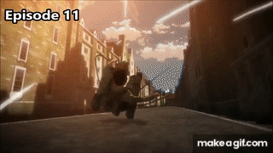
Notes:
40

Slide 3
Thesis
Attack on Titan draws several characteristics from modern Western zombie cinema, including the notion of a survival space, as well as having zombie-like antagonists known as Titans that specifically target humans and possess an unnecessary, yet daunting thirst to consume human life. However, Titans also have notable differences from modern zombies, and horror is not produced in the same manner as Western zombie films, both of which are largely due to Japanese tradition and culture.
Notes:
30 Change in social factors in altering the survival space and the social interaction caused by anime format vs video games and movies

Slide 4

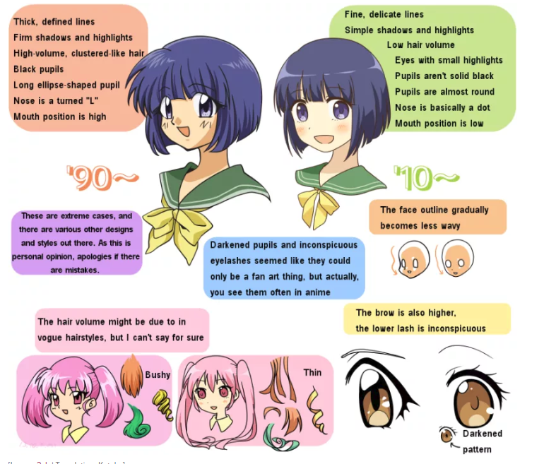
Artstyle of Anime
Notes:
1:40 Many anime and manga characters feature large eyes. Osamu Tezuka, who is believed to have been the first to use this technique, was inspired by the exaggerated features of American cartoon characters such as Betty Boop, Mickey Mouse, and Disney's Bambi.[3][28] Tezuka found that large eyes style allowed his characters to show emotions distinctly.

Slide 5
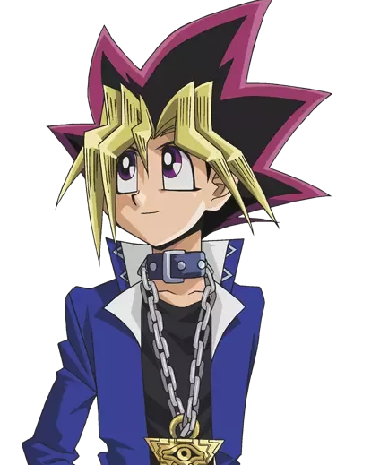
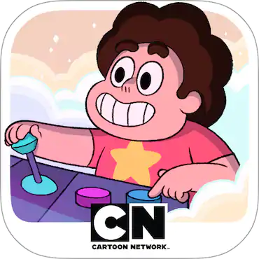
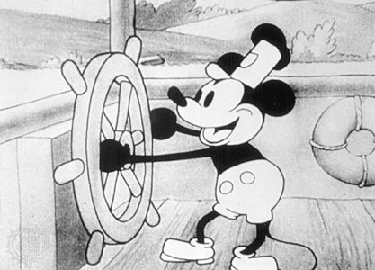
Notes:
Another characteristic is how they draw the eyes always with light in them;
disproportionately large eyes. With colorful irises
The round ink brush traditionally used for writing kanji and for painting, produces a stroke of widely varying thickness.Anime came from Manga = which was inspired
https://sites.google.com/site/theanimecode/visual-characteristics

Slide 6
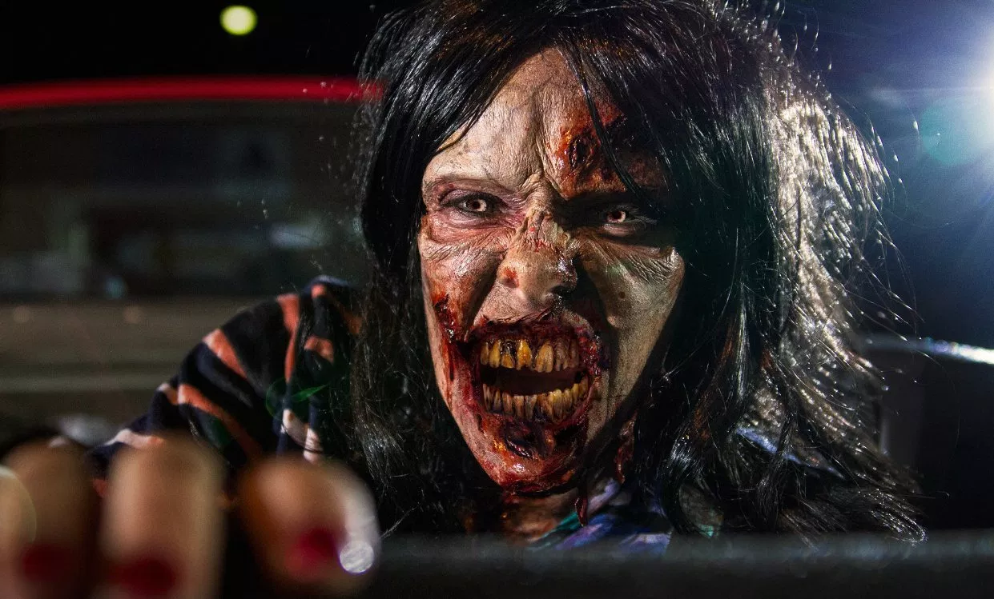
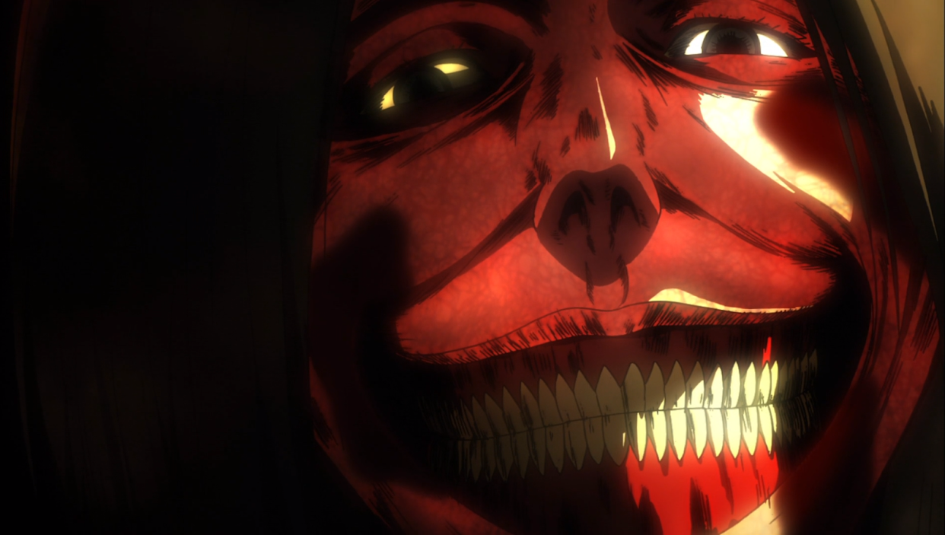
ARTSTYLE
Realistic
Animated
Notes:
Changing artistic effect = need another form to bring horror or repulsion to the REAL audience. Ez audience to form a difference btw reality

Slide 7
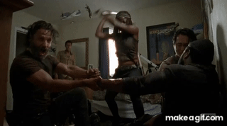
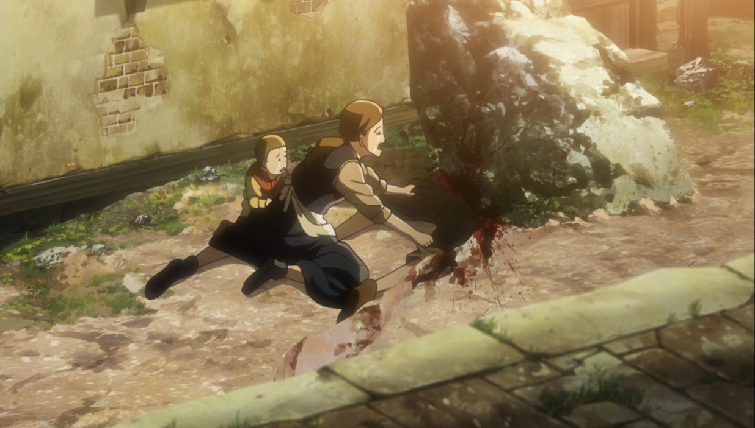
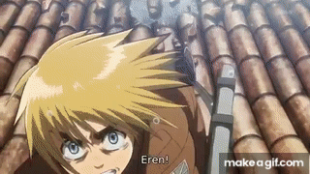
Notes:
Walking dead from
THe eyes make it distictly non heamn therefor there is a distanct from realism. That make a disconnection btw human and anime vs human and live action

Slide 8
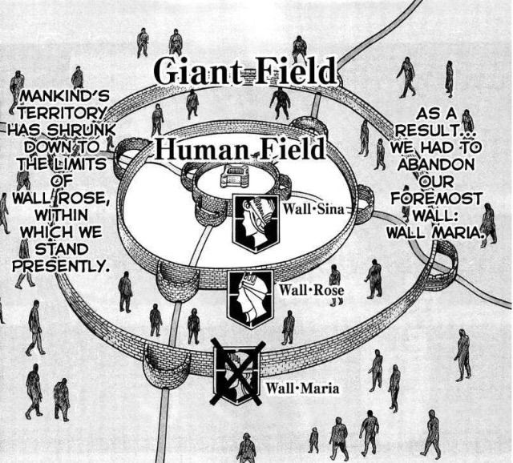
Survival Space in Attack on Titan
Notes:
1:20 As per the first part of the thesis, our group has noticed that the primary setting of Attack on Titan, the 3 major walls that contain the remains of humanity, share many features with the “survival space” that appears consistently in Western zombie films.
3 Walls: agricultural, suburban, urban center
Like the survival space that slowly devolves into chaos in Romero’s films, the main plot of AoT unfolds when the outermost wall is attacked, titans begin to invade agricultural section, & the population is wiped out in agricultural section. This causes a famine and resulting influx of refugees, creating chaos for the remaining sections
Rather than chaos being brought upon by the inhabitants, though, it is much more so due to the Titans; humans are not at fault
This single survival space has a scale much greater than those in Western zombie films

Slide 9
Titan vs. Zombie
Differences between titan and zombie:
Titan | Zombie
Killed by cut to back of the neck | Killed by gunshot/hard blow to head
Typically 10-50 feet tall | Human-sized
Method of reproduction = unknown | Make humans zombies via infection
Similarities between titan and zombie:
Irrational desire to consume flesh
Effective & Deadly in groups
Target humans specifically
Notes:
1:20 - It is important to note that while titans are similar to regular Western zombies, there are some important differences and thus they are not quite equivalent.
Zombies & titans consume flesh BUT ⇒ zombies gnaw/feed on human meat whereas titans eat humans whole
Humans eaten whole by titans are vomited up & remain dead, whereas zombie victims are reanimated
Horrific nature & overall post-apocalyptic, limited-resourced nature of Attack on Titan deems it similar enough to zombie films to be compared

Slide 10
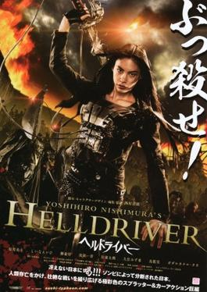
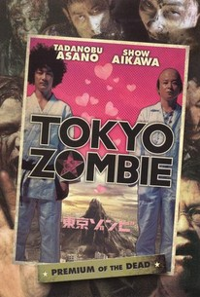
Japanese Zombie Cinema
Notes:
Considered a sub-genre of general Japanese horror
Tends to capitalize on the notion of the Japanese spirit rather than zombies or vampires
Films that present the more prominent Western zombie have infection/virus-based/mutation plots, not undead
Oftentimes non-serious plots, in contrast to Western zombie films (zombie comedy to be discussed)
Tends to differ from Western zombie cinema, but primarily in that Japanese culture and films tend to incorporate a variety of other cultures into their ideas to create distinctly new ideas

Slide 11
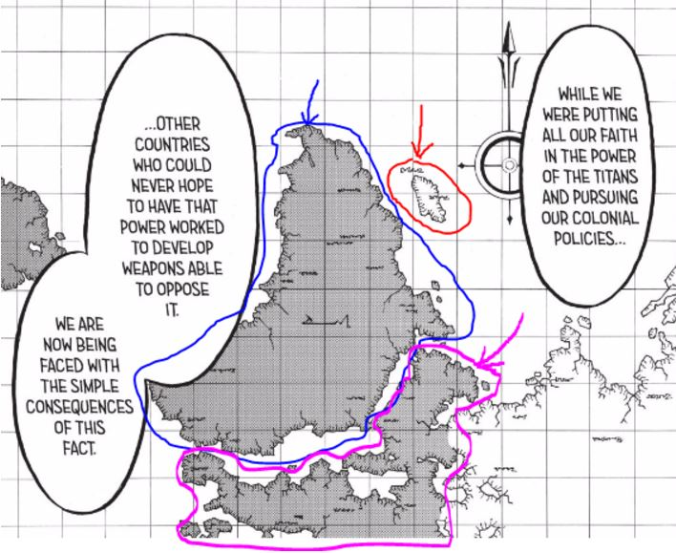
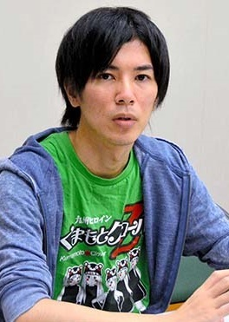
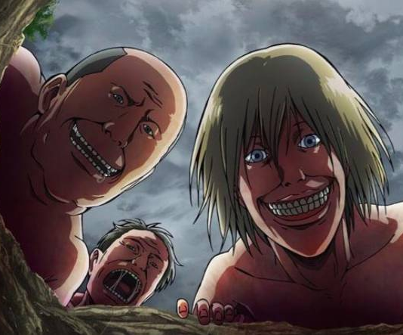
Japanese Zombie Comedy
“They never stop smiling. It gives a obnoxious emotion. Also is not that I want them to be scary as hell but also they can seem funny even on a level of stupidity some people might find them that way except that everyone decides how they want to see them as and either or I just wanted to show something weird.”
諫山 創 (Hajime Isayama)
Notes:
1:30 SCRIPT:
The question is why Japanese Zombie Comedy. Lets looks back at Japanese fears and they are primarily with ghosts. Zombies are not native to Japan therefore have a foreign effect as such many films are set to a world that is not in Japan as well as it not being a possibility since the japanese cremate their dead. Romero's zombies represented the fear of individuality being wiped out and absorbed into a mass consumer horde—fears that don't resonate with the rather collectivist Japanese population. Zombies soon in Japan have been overused until A zombie is no longer an icon of fear. A zombie is just a zombie. So the Japanese filmmakers pioneered another type of film like George Romero which is now Zombie Comedy which is applied in Attack on Titan by the author through an interview Hajime Isayama where he roughly says
If you look the titans don't change their faces from the moment they encounter someone until they kill them. They never stop smiling. It gives a obnoxious emotion. Also is not that I want them to be scary as hell but also they can seem funny even on a level of stupidity some people might find them that way except that everyone decides how they want to see them as and either or I just wanted to show something weird.

Slide 12
Bibliography
Barrett, Rudy. “Why Japan Laughs At Zombies.” Tofugu, Tofugu, 24 June 2014, www.tofugu.com/japan/japanese-zombies/.
Browning, John Edgar. “Survival Horrors, Survival Spaces: Tracing the Modern Zombie (Cine) Myth through to the Postmillenium .” Zombie Talk: Culture, History, Politics, by David R. Castillo et al., Palgrave Macmillan, 2016, pp. 15–19.
Fisher, Max. “How Japan Has Virtually Eliminated Shooting Deaths.” The Atlantic, Atlantic Media Company, 3 Dec. 2015, www.theatlantic.com/international/archive/2012/07/a-land-without-guns-how-japan-has-virtually-eliminated-shooting-deaths/260189/.
Fukunaga, Natsuki. “‘Those Anime Students’: Foreign Language Literacy Development Through Japanese Popular Culture.” The Reading Teacher, Wiley-Blackwell, 9 Nov. 2011,ila.onlinelibrary.wiley.com/doi/epdf/10.1598/JAAL.50.3.5.
Murphy, Kayleigh, and Mark David Ryan. “Undead Yakuza: The Japanese Movie, Cultural Resonance, and Generic Conventions.” The Supernatural Revamped: from Timeworn Legends to Twenty-First-Century Chic, by Barbara Brodman and James E. Doan, Fairleigh Dickinson University Press, 2017, pp. 193–195.
Norris, CJ, Manga, Anime and Visual Art Culture, The Cambridge Companion to Modern Japanese Culture, Cambridge University Press, Yoshio Sugimoto (ed), Melbourne, pp. 236-260. ISBN 9780521880473 (2009) [Research Book Chapter]
Notes:
Fukunaga - google scholar
Norris - book
https://sites.google.com/site/theanimecode/visual-characteristics - website

